Slide 1


CS 6831 Designing Secure Cryptography
Tom Ristenpart

Slide 2


Diffie-Hellman Key Exchange
X
Pick random x from Z_{|G|}
X = g^{x}
Y
Pick random y from Z_{|G|}
Y = g^{y}
K = H(Y^{x})
K = H(X^{y})
Get the same key. Why?
Y^{x} = g^{yx} = g^{xy} = X^{y}
Only provides security against passive attackers

Slide 3

Man-in-the-middle attacks
Suppose authentication vulnerability:
g^{x}
g^{x2}
g^{y2}
g^{y}
Client
Server
Attacker can choose x2, y2, and complete DH exchange with both sides
All communications decrypted by adversary, re-encrypted and forwarded to server

Slide 4
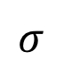
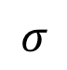
Digital signatures
key generation
kg
Signing is often randomized
sk
pk
sign
M
ver
M
$$σ$$
0 / 1
$$σ$$
Anyone with public key can verify a signature
Only holder of secret key should be able to generate a signature

Slide 5

Man-in-the-middle attacks
Suppose authentication vulnerability:
g^{x}
g^{x2}
g^{y2}
g^{y}
Client
Server
Attacker can choose x2, y2, and complete DH exchange with both sides
All communications decrypted by adversary, re-encrypted and forwarded to server

Slide 6
TLS handshake for Diffie-Hellman Key Exchange
Client
Server
ClientHello, MaxVer, Nc, Ciphers/CompMethods
Pick random Nc
Check CERT
using CA public
verification key
Check σ
ServerHello, Ver, Ns, SessionID, Cipher/CompMethod
Pick random Ns
CERT = (pk_{s} , signature over it)
Pick random x
X = g^{x}
p , g , X , σ = sign(sk_{s}, Nc||Ns||p||g||X)
Pick random y
Y = g^{y}
Y
PMS = g^{xy}
ChangeCipherSpec,
{ Finished, PRF(MS, “Client finished” || H(transcript)) }
PMS = g^{xy}
ChangeCipherSpec,
{ Finished, PRF(MS, “Server finished” || H(transcript’)) }
Bracket notation
means contents
encrypted
MS <- PRF(PMS, “master secret” || Nc || Ns )

Slide 7
Apple iOS <7.0.16 signature verification code

Slide 8

Man-in-the-middle attacks
Suppose authentication vulnerability:
CERT can be forged, Client doesn’t check CERT, etc.
ClientHello
ClientHello
ServerHello
ServerHello
Client
Server
CERT’ = (pk*, signature over it)
CERT = (pk_{S} , signature over it)
p, g, X*, sign(sk*, Nc||Ns||p||g||X*)
p, g, X, sign(sk_{S} , Nc||Ns||p||g||X)
Y
Y*
Attacker can choose X*, Y*, so it knows discrete logs
Completes handshake on both sides
Client thinks its talking to Server
All communications decrypted by adversary, re-encrypted and forwarded to server

Slide 9
Unforgeability under chosen message attack (UF-CMA)
Adversary can’t generate valid message, signature pair without secret key, but with signing oracle
Same as UF-CMA for message authentication schemes, but give pk to adversary

Slide 10
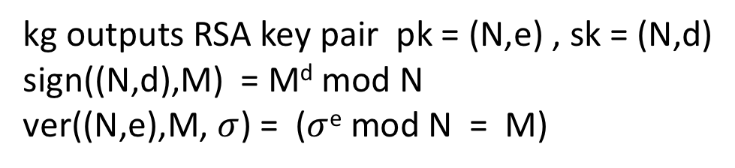
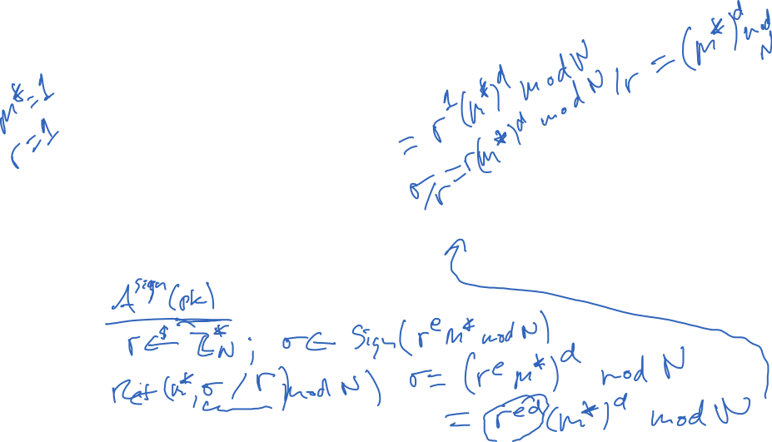
Plaintext RSA as a signature scheme:
kg outputs RSA key pair pk = (N,e) , sk = (N,d)
sign((N,d),M) = M^{d} mod N
ver((N,e),M, $σ$) = ($σ$^{e} mod N = M)
UF-CMA secure?
No!
Existential forgery: forgery for some M
Universal forgery: forgery for any given M
Notes:
- M = 1 , sigma = 1
- sigma = Sign(M)
Ret (M^2 mod N , sigma^2 mod N)
- Pick any sigma
M = sigma^e mod N
ret (M,sigma)
Universal forger
pick R ad submit RM

Slide 11
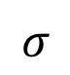
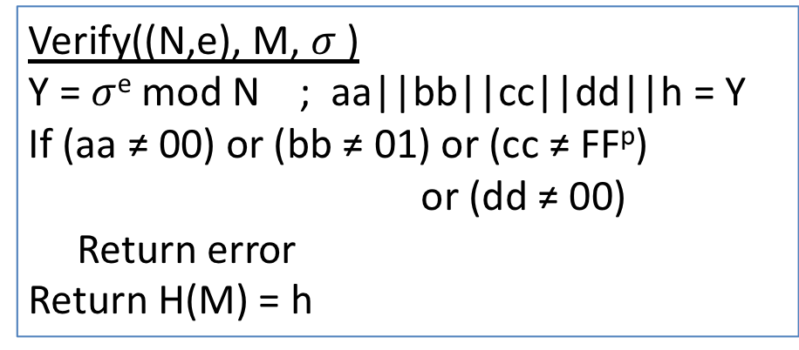
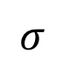
PKCS #1 v1.5 RSA signing
kg outputs (N,e),(N,d) where |N|₈ = n
Let H be hash function with output length m bytes
Let p = n – m – 3
(N,d)
Sign((N,d), M)
Y = 00 || 01 || FF^{p} || 00 || H(M)
Return Y^{d} mod N
sign
M
$$σ$$
Verify((N,e), M, $σ$ )
Y = $σ$^{e} mod N ; aa||bb||cc||dd||h = Y
If (aa ≠ 00) or (bb ≠ 01) or (cc ≠ FF^{p}) or (dd ≠ 00)
Return error
Return H(M) = h
pk
M
ver
0 / 1
$$σ$$

Slide 12
PKCS#1 v1.5 digital signature security
Padding oracle attacks that work against RSA PKCS#1 v1.5 decryption can be used to forge PKCS#1 v1.5 signatures as well

Slide 13
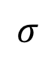
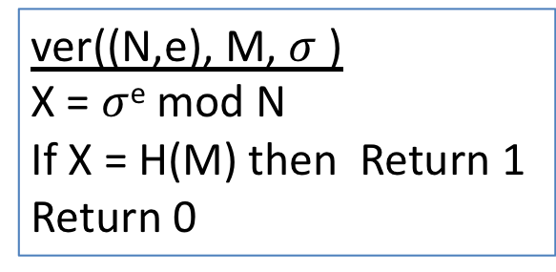
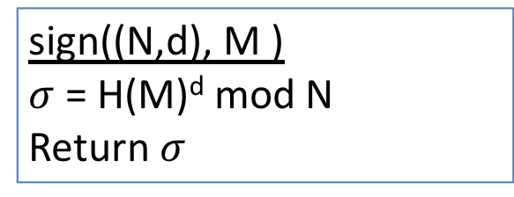
Full Domain Hash RSA
Kg outputs pk = (N,e) , sk = (N,d)
Cryptographic hash function, modeled as RO
(N,d)
sign((N,d), M )
$σ$ = H(M)^{d} mod N
Return $σ$
sign
Technical issue with H:
Depends on public key
In practice fix output length and build H indifferentiable from RO using existing hashes
M
$$σ$$
ver((N,e), M, $σ$ )
X = $σ$^{e} mod N
If X = H(M) then Return 1
Return 0
(N,e)
M
ver
0 / 1
$$σ$$

Slide 14
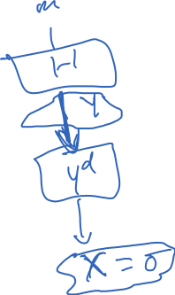

Slide 15
Simplifying assumptions about A:
Always queries H(M) before Sign(M)
Queries H(M*)
Never queries H or Sign twice on same M
Doesn’t query Sign(M*)
Why? Can build such an A’ s.t. adv of A’ at least as much as A’s
A’ has at most q = q_{h} + q_{s} + 1 RO queries

Slide 16
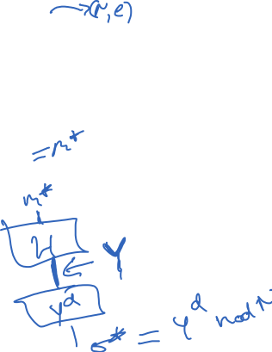
Toy case: 1 RO query and no signing queries
Simply reply with OWF challenge Y to the single H query, which must be on M* (by our restrictions on A)

Slide 17
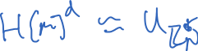
Toy case: 1 RO query and no signing queries
Simply reply with OWF challenge Y to the single H query, which must be on M* (by our restrictions on A)
Why? Because Y is randomly distributed point, and
Thus, $σ$* is the preimage X of Y, solving OWF game
Challenges for reduction in general case:
Many RO queries, not clear a priori for which message to set H[M] = Y
How do we answer signing queries?

Slide 18
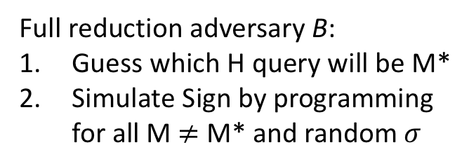
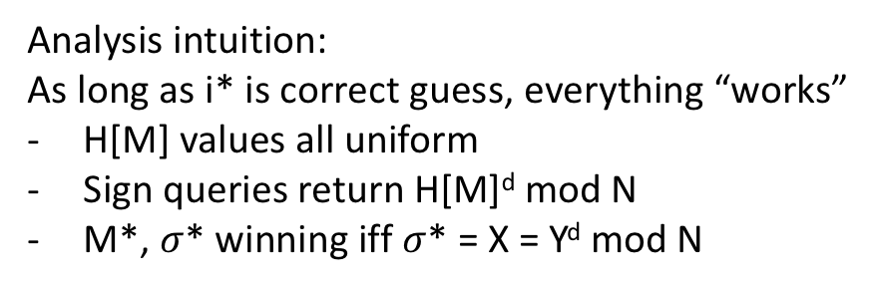
Full reduction adversary B:
Guess which H query will be M*
Simulate Sign by programming
for all M $≠$ M* and random $σ$
Analysis intuition:
As long as i* is correct guess, everything “works”
H[M] values all uniform
Sign queries return H[M]^{d} mod N
M*, $σ$* winning iff $σ$* = X = Y^{d} mod N

Slide 20
Identical-until-bad arguments we’ve seen won’t quite work here:
Need variant of fundamental lemma
G₀ and G₁ identical-until-bad
good₀ and good₁ be events that bad not set in G₀ and G₁

Slide 21
This argument works:
Recalling q = q_{h} + q_{s} + 1, we get advantage statement
Need variant of fundamental lemma
G₀ and G₁ identical-until-bad
good₀ and good₁ be events that bad not set in G₀ and G₁

Slide 22
Slightly different proof approaches in [Boneh-Shoup] and [Bellare-Rogaway] notes
Concrete security implications?
Notes:
q_h is number of hash computations allowed to adversary A. So could be close to 2⁸⁰, for theorem to apply need to set k to be larger
Say Adv(B) = (1/2)^40 for for some RSA key size k and time allotment t. (Can estimate via NFS algorithm runtime) But now if q_h = 2^80 then we have a problem. So need to set RSA key size k bigger if we want theorem guarantee to hold
But no attack seems to work better than solving RSA. Nevertheless can we get a better proof?

Slide 23
Slightly different proof approaches in [Boneh-Shoup] and [Bellare-Rogaway] notes
Clever proof approach using random self-reducibility of RSA
Key idea: embed OWF challenge Y in multiple H[M] values
See [Boneh-Shoup] for details
Notes:
q_h is number of hash computations allowed to adversary A. So could be close to 2⁸⁰

Slide 24
Tight reductions to RSA?
Can we get even better reductions?
Still factor q_{s} multiplicative loss in advantage. Would prefer:
for tiny epsilon
Probabilistic signature scheme (PSS) [Bellare, Rogaway 1996]
Randomizes signing (add random salt to FDH hash)
Allows tight proof
Coron shows negative result for schemes with “unique” signatures
PRF-based variant [Katz, Wang 2003]
Sidesteps negative result to build deterministic (but not unique) signature scheme
Clever use of a PRF: H(F(K,M),M)^{d} mod N

Slide 26
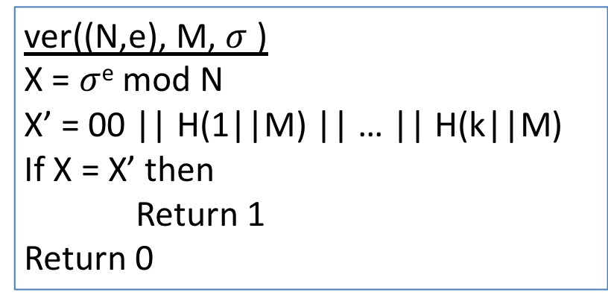
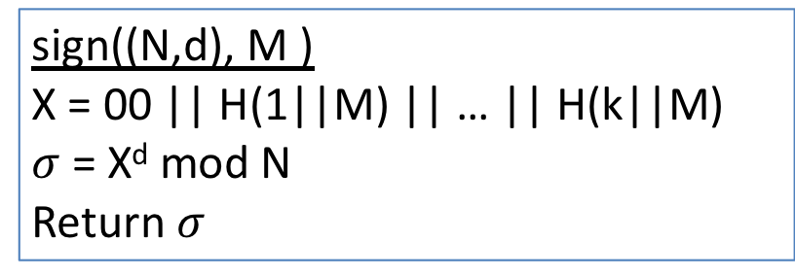
Full Domain Hash RSA
Kg outputs pk = (N,e) , sk = (N,d) where |N|₈ = n
H is hash with m-byte output k = ceil( (n – 1)/m )
(N,d)
sign((N,d), M )
X = 00 || H(1||M) || … || H(k||M)
$σ$ = X^{d} mod N
Return $σ$
sign
M
$$σ$$
ver((N,e), M, $σ$ )
X = $σ$^{e} mod N
X’ = 00 || H(1||M) || … || H(k||M)
If X = X’ then
Return 1
Return 0
(N,e)
M
ver
0 / 1
$$σ$$
Probabilistic Signature Scheme (PSS) provides stronger security bounds
and also deployed now, see PKCS#1 v2

Slide 27
Trapdoor functions
easy given pk
X
f_{pk}(X)
X is randomly chosen from domain
hard given pk
easy given sk

Slide 28
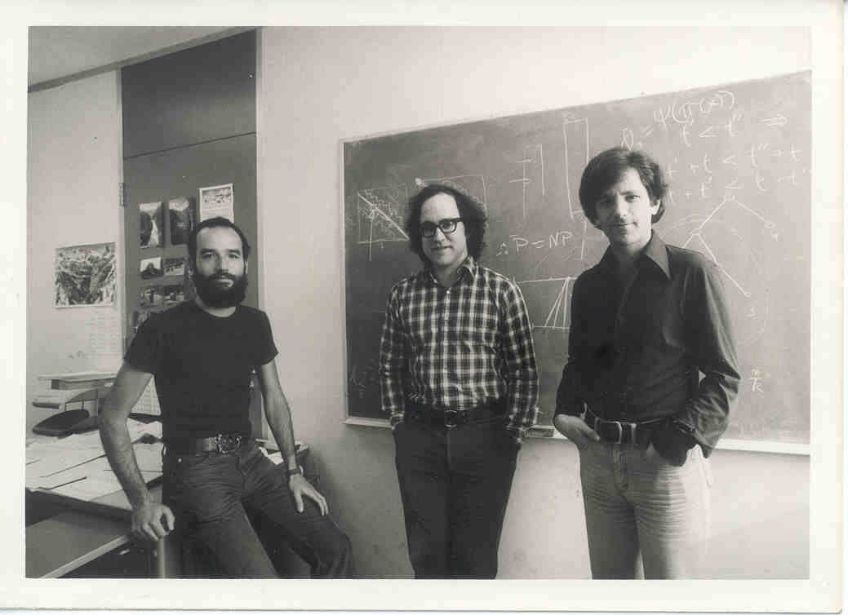
The RSA trapdoor function
Rivest, Shamir, Adleman 1978
Garnered them a Turing award

Slide 29
RSA math
Let N be a positive number
Looking ahead: N = pq for large primes p,q
N will be called the modulus
Z_{N} = {0,1,2,3,…, N-1}
Z_{N} = { i | gcd(i,N) = 1 and i < N}
*
gcd(X,Y) = 1 if greatest common divisor of X,Y is 1

Slide 30
RSA math
Z_{N} = { i | gcd(i,N) = 1 }
*
N = 13
Z₁₃ = { 1,2,3,4,5,6,7,8,9,10,11,12 }
*
N = 15
Z₁₅ = { 1,2,4,7,8,11,13,14 }
*
The size of a set S is denoted by |S|
Def. φ(N) = |Z_{N}| (This is Euler’s totient function)
*
φ(13) =
12
Z_{φ(15)} = Z₈ = { 1,3,5,7 }
*
*
φ(15) =
8

Slide 31
RSA math
Z_{N} = { i | gcd(i,N) = 1 }
*
Fact. For any a,N with N > 0, there exists unique q,r
such that
a = Nq + r and 0 ≤ r < N
Def. a mod N = r Z_{N}
Def. a b (mod N) iff (a mod N) = (b mod N)
Operations work in natural way:
a • b mod N a+b mod N

Slide 32
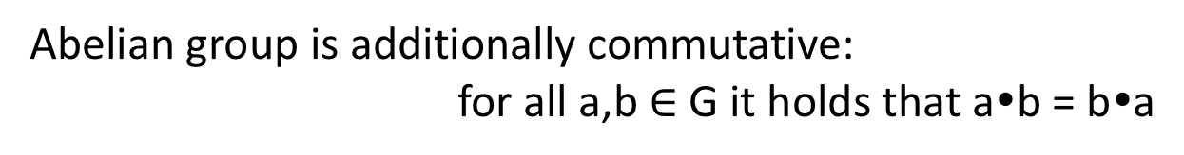
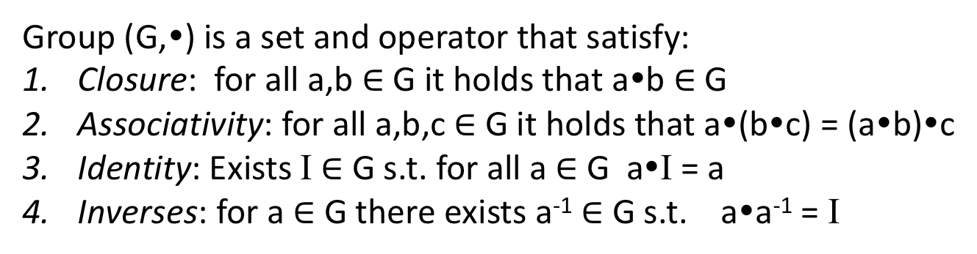
RSA math
Z_{N} = { i | gcd(i,N) = 1 }
*
(Z_{N} , •) is a group where • denotes multiplication mod N
*
Group (G,•) is a set and operator that satisfy:
Closure: for all a,b $∈$G it holds that a•b $∈$ G
Associativity: for all a,b,c $∈$G it holds that a•(b•c) = (a•b)•c
Identity: Exists I $∈$ G s.t. for all a $∈$ G a•I = a
Inverses: for a $∈$ G there exists a⁻¹ $∈$ G s.t. a•a⁻¹ = I
Abelian group is additionally commutative:
for all a,b $∈$G it holds that a•b = b•a

Slide 33
RSA math
Z_{N} = { i | gcd(i,N) = 1 }
*
(Z_{N} , •) is a group
*
Z₁₅ = { 1,2,4,7,8,11,13,14 }
*
2•7 14 (mod 15)
4•8 2 (mod 15)
Closure: for any a,b Z_{N} a•b mod N Z_{N}
*
*
Def. a^{i} mod N = a•a•a•…•a mod N
i times

Slide 34
Some needed algorithms
Algorithm | Running time (n = log N)
Modular multiplication ab mod N | O(n²)
Modular exponentation a^{i} mod N | O(n³)
Modular inverse a⁻¹ mod N | O(n²)

Slide 35
Textbook exponentiation
Let G be a group.
How do we compute h^{x} for any h G?
Exp(h,x)
X’ = h
For i = 2 to x do
X’ = X’•h
Return X’
SqrAndMulExp(h,x)
b_{k},…,b₀ = x
f = 1
For i = k down to 0 do
f = f²
If b_{i} = 1 then
f = f•h
Return f
Requires time O(|G|) in
worst case.
Requires time O(k) multiplies and
squares in worst case.

Slide 36
SqrAndMulExp(h,x)
b_{k},…,b₀ = x
f = 1
For i = k down to 0 do
f = f²
If b_{i} = 1 then
f = f*h
Return f
h¹¹ = h⁸⁺²⁺¹ = h⁸ • h² • h
b₃ = 1
f₃ = 1 • h
Don’t implement this algorithm:
side-channel attacks
b₂ = 0
f₂ = h²
b₁ = 1
f₁ = (h²)² • h
b₀ = 1
f₀ = (h⁴ • h)² • h
= h⁸ • h² • h

Slide 37
RSA math
Z_{N} = { i | gcd(i,N) = 1 }
*
Claim: Suppose e,d Z_{φ(N)} satisfying ed mod φ(N) = 1
then for any x Z_{N} we have that
(x^{e})^{d} mod N = x
*
*
x^{ed} mod N = x^{1 + k φ(N)} mod N
= x¹ x^{k φ(N)} mod N
= x mod N
By Euler’s Theorem:
x^{φ(N)} = 1 (mod N)

Slide 38
RSA math
Z_{N} = { i | gcd(i,N) = 1 }
*
Claim: Suppose e,d Z_{φ(N)} satisfying ed mod φ(N) = 1
then for any x Z_{N} we have that
(x^{e})^{d} mod N = x
*
*
Z₁₅ = { 1,2,4,7,8,11,13,14 }
Z_{φ(15)} = { 1,3,5,7 }
*
*
e = 3 , d = 3 gives ed mod 8 = 1
x | 1 | 2 | 4 | 7 | 8 | 11 | 13 | 14
x³ mod 15 | 1 | 8 | 4 | 13 | 2 | 11 | 7 | 14
y³ mod 15 | 1 | 2 | 4 | 7 | 8 | 11 | 13 | 14

Slide 39
The RSA trapdoor permutation
pk = (N,e)
sk = (N,d)
with ed mod φ(N) = 1
f_{N,e}(x) = x^{e} mod N
g_{N,d}(y) = y^{d} mod N
easy given N,e
X
f_{pk}(X)
hard given N,e
easy given N,d

Slide 40
The RSA trapdoor permutation
pk = (N,e)
sk = (N,d)
with ed mod φ(N) = 1
f_{N,e}(x) = x^{e} mod N
g_{N,d}(y) = y^{d} mod N
But how do we find suitable N,e,d ?
If p,q distinct primes and N = pq then φ(N) = (p-1)(q-1)
Why?
φ(N) = |{1,…,N-1}| - |{ip : 1 ≤ i ≤ q-1}| - |{iq : 1 ≤ i ≤ p-1}|
= N-1 - (q-1) - (p-1)
= pq – p – q + 1
= (p-1)(q-1)

Slide 41
The RSA trapdoor permutation
pk = (N,e)
sk = (N,d)
with ed mod φ(N) = 1
f_{N,e}(x) = x^{e} mod N
g_{N,d}(y) = y^{d} mod N
But how do we find suitable N,e,d ?
If p,q distinct primes and N = pq then φ(N) = (p-1)(q-1)
Given φ(N), choose e Z_{φ(N)} and calculate
d = e⁻¹ mod φ(N)
*
How to find suitable p,q prime?
Choose random numbers and test primality (Miller-Rabin testing)
https://eprint.iacr.org/2018/749.pdf

Slide 42
Summary
Find 2 large primes p, q . Let N = pq
random integers + primality testing
Choose e (usually 65,537)
Compute d using φ(N) = (p-1)(q-1)
pk = (N,e) and sk = (N,d)
Often store p,q with sk to use Chinese Remainder Theorem

Slide 43
Public-key encryption
key generation
kg is randomized
Sometimes explicitly takes as input a security parameter k
kg
Encryption often randomized
pk
sk
enc
dec
M or
error
M
C
C
C is a ciphertext
Correctness: dec( sk , enc(pk,M) ) = M with probability 1 over randomness used by enc

Slide 44
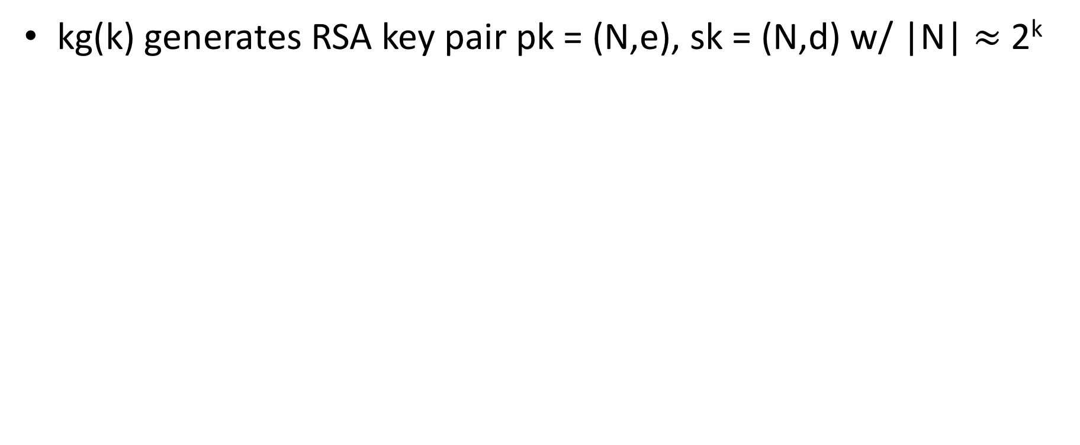
A simple scheme from RSA
kg(k) generates RSA key pair pk = (N,e), sk = (N,d) w/ |N| $≈$ 2^{k}
Hash function with suitable msg space
One-time secure SE scheme
kg_{s} outputs random n-bit string

Slide 45
IND-CPA for PKE
Left-or-right indistinguishability notion is traditional CPA security goal
Real-vs-randomized ciphertext not as easy here: ciphertexts are often distinguishable from random bit strings. Why for RSA?
Sufficient to consider adversaries that make a single query to Enc

Slide 46
IND-CPA for PKE
We’ll use a classic hybrid argument approach

Slide 47




Define games G_{i*} for i* = 0, 1, … ,q
G₀ replies to all queries with encryptions of M₁
IND-CPA1
G₁ replies to first query with encryption of M₀ , rest M₁
G₂ replies to first two queries with encryption of M₀ , rest M₁
…
G_{q} replies to all queries with encryptions of M₀
IND-CPA0

Slide 48
IND-CPA1
IND-CPA0
Pr[G₀] – Pr[G₁] + Pr[G₁] – Pr[G₂] + … + Pr[G_{q-1}] - Pr[G_{q}]
Let B_{i*} be single-query IND-CPA adversary that “switches” between G_{i-1} & G_{i}

Slide 49

IND-CPA1
IND-CPA0
Pr[G₀] – Pr[G₁] + Pr[G₁] – Pr[G₂] + … + Pr[G_{q-1}] - Pr[G_{q}]
Let B_{i*} be single-query IND-CPA adversary that “switches” between G_{i*-1} & G_{i*}
Let B be single-query IND-CPA adversary that chooses j randomly and runs B_{j}

Slide 50
A simple scheme from RSA
kg(k) generates RSA key pair pk = (N,e), sk = (N,d) w/ |N| $≈$ 2^{k}
Hash function with suitable msg space
One-time secure SE scheme
kg_{s} outputs random n-bit string

Slide 51
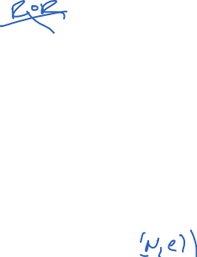

Slide 53
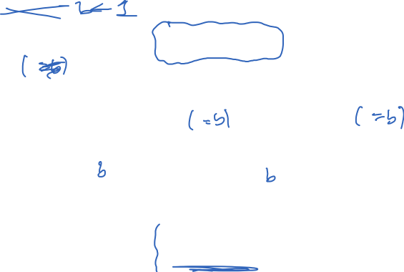


Slide 54
How hard is inverting RSA?
Learning p,q from N is
the factoring problem
We don’t know if inverse is true, whether inverting RSA implies ability to factor

Slide 55
Factoring composites
Factor(N):
for i = 2 , … , sqrt(N) do
if N mod i = 0 then
p = i
q = N / p
Return (p,q)
Run time is sqrt(N)
O(sqrt(N)) = O(e^{0.5 ln(N)})

Slide 56
Factoring composites
Algorithm | Time to factor N
Naïve | O(e^{0.5 ln(N)})
Quadratic sieve (QS) | O(e^{c} ) c = d (ln N)^{1/2} (ln ln N)^{1/2}
Number Field Sieve (NFS) | O(e^{c} ) c = 1.92 (ln N)^{1/3} (ln ln N)^{2/3}

Slide 57
Factoring records
Challenge | Year | Algorithm | Time
RSA-400 | 1993 | QS | 830 MIPS years
RSA-478 | 1994 | QS | 5000 MIPS years
RSA-515 | 1999 | NFS | 8000 MIPS years
RSA-768 | 2009 | NFS | ~2.5 years
RSA-512 | 2015 | NFS | $75 on EC2 / 4 hours
RSA-x is an RSA challenge modulus of size x bits

Slide 59
PKCS #1 RSA encryption
Kg outputs (N,e),(N,d) where |N|₈ = n
Let B = {0,1}⁸ / {00} be set of all bytes except 00
Want to encrypt messages of length |M|₈ = m
(N,e)
Enc((N,e), M, R)
pad = first n - m - 3 bytes from R that
are in B
X = 00 || 02 || pad || 00 || M
Return Xe mod N
R
Enc
C
M
(N,d)
Dec((N,d), C )
X = C^{d} mod N ; aa||bb||w = X
If (aa ≠ 00) or (bb ≠ 02) or (00 w)
Return error
pad || 00 || M = w
Return M
Dec
M or
error
C

Slide 60
Hybrid encryption
Kg outputs (pk,sk)
pk
Enc(pk, M, R)
K||R1||R2 = R
C1 = Enc(pk,K,R1)
C2 = Enc(K,M,R2)
Return (C1,C2)
R
Enc
C
M
sk
Dec(sk, (C1,C2) )
K = Dec(sk,C1)
M = Dec(K,C2)
Return M
Dec
M or
error
C

Slide 61
TLS handshake for RSA transport
Bank customer
Bank
ClientHello, MaxVer, Nc, Ciphers/CompMethods
Pick random Nc
ServerHello, Ver, Ns, SessionID, Cipher/CompMethod
Pick random Ns
Check CERT
using CA public
verification key
CERT = (pk of bank, signature over it)
C
Pick random PMS
C <- E(pk,PMS)
PMS <- D(sk,C)
ChangeCipherSpec,
{ Finished, PRF(MS, “Client finished” || H(transcript)) }
ChangeCipherSpec,
{ Finished, PRF(MS, “Server finished” || H(transcript’)) }
Bracket notation
means contents
encrypted
MS <- PRF(PS, “master secret” || Nc || Ns )

Slide 62
Security of RSA PKCS#1
Passive adversary sees (N,e),C
Attacker would like to invert C
Possible attacks?

Slide 63
Security of RSA PKCS#1
Passive adversary sees (N,e),C
Attacker would like to invert C
Possible attacks?
Pick |N| > 1024 and factoring will fail
Active attacks?

Slide 64
Bleichanbacher attack
C₁
I’ve just learned
some information
about C₁^{d} mod N
Dec((N,d), C )
X = C^{d} mod N ; aa||bb||w = X
If (aa ≠ 00) or (bb ≠ 02) or (00 w)
Return error
pad || 00 || M = w
Return M
padding error?
C₂
padding error?
…
We can take a target C and decrypt it using
a sequence of chosen ciphertexts C₁, … , C_{q}
where q ≈ 1 million
[Bardou et al. 2012] q = 9400 ciphertexts on average

Slide 65
Response to this attack
Ad-hoc fix: Don’t leak whether padding was wrong or not
This is harder than it looks (timing attacks, control-flow side channel attacks, etc.)
Better:
use chosen-ciphertext secure encryption
OAEP is common choice

Slide 66
Summary
RSA is example of trapdoor one-way function
Security conjectured. Relies on factoring being hard
RSA security scales somewhat poorly with size of primes
RSA PKCS#1 v1.5 is insecure due to padding oracle attacks. Don’t use it in new systems.
Use OAEP instead

Slide 67
TLS handshake for Diffie-Hellman Key Exchange
Client
Server
ClientHello, MaxVer, Nc, Ciphers/CompMethods
Pick random Nc
Check CERT
using CA public
verification key
Check σ
ServerHello, Ver, Ns, SessionID, Cipher/CompMethod
Pick random Ns
CERT = (pk_{s} , signature over it)
Pick random x
X = g^{x}
p , g , X , σ = Sign(sk_{s}, p || g || X)
Pick random y
Y = g^{y}
Y
PMS = g^{xy}
ChangeCipherSpec,
{ Finished, PRF(MS, “Client finished” || H(transcript)) }
PMS = g^{xy}
ChangeCipherSpec,
{ Finished, PRF(MS, “Server finished” || H(transcript’)) }
Bracket notation
means contents
encrypted
MS <- PRF(PMS, “master secret” || Nc || Ns )

Slide 68
Diffie-Hellman math
Let p be a large prime number
Fix the group G = Z_{p} = {1,2,3,…, p-1}
Then G is cyclic. This means one can give a
member g G , called the generator, such that
Example: p = 7. Is 2 or 3 a generator for Z₇ ?
*
G = { g⁰, g¹, g², … , g^{p-1} }
*
x | 0 | 1 | 2 | 3 | 4 | 5 | 6
2^{x} mod 7 | 1 | 2 | 4 | 1 | 2 | 4 | 1
3^{x} mod 7 | 1 | 3 | 2 | 6 | 4 | 5 | 1

Slide 69
Textbook exponentiation
Let G be cyclic group.
How do we compute h^{x} for any h G?
ModExp(h,x)
X’ = h
For i = 2 to x do
X’ = X’*h
Return X’
SqrAndMulExp(h,x)
b_{k},…,b₀ = x
f = 1
For i = k down to 0 do
f = f² mod N
If b_{i} = 1 then
f = f*h
Return f
Requires time O(|G|) in
worst case.
Requires time O(k) multiplies and
squares in worst case.

Slide 70
SqrAndMulExp(h,x)
b_{k},…,b₀ = x
f = 1
For i = k down to 0 do
f = f² mod N
If b_{i} = 1 then
f = f*h
Return f
h¹¹ = h⁸⁺²⁺¹ = h⁸ • h² • h
b₃ = 1
f₃ = 1 • h
b₂ = 0
f₂ = h²
b₁ = 1
f₁ = (h²)² • h
b₁ = 1
f₀ = (h⁴ • h)² • h
= h⁸ • h² • h

Slide 71
The discrete log problem
Fix a cyclic group G with generator g
Pick x at random from Z_{|G|}
Give adversary g, X = g^{x} . Adversary’s goal is to compute x
easy
x
g^{x}
hard

Slide 72
The discrete log problem
Fix a cyclic group G with generator g
Pick x at random from Z_{|G|}
Give adversary g, X = g^{x} . Adversary’s goal is to compute x
Very slow for large groups!
O(|G|)
Baby-step giant-step is better:
O(|G|^{0.5})
Nothing faster is known for some
groups.
A(X):
for i = 2 , … , |G|-1 do
if X = g^{i} then
Return i

Slide 73
Diffie-Hellman Key Exchange
X
Pick random x from Z_{|G|}
X = g^{x}
Y
Pick random y from Z_{|G|}
Y = g^{y}
K = H(Y^{x})
K = H(X^{y})
Get the same key. Why?
Y^{x} = g^{yx} = g^{xy} = X^{y}
What type of security does this protocol provide?

Slide 74
Computational Diffie-Hellman Problem
Fix a cyclic group G with generator g
Pick x,y both at random Z_{|G|}
Give adversary g, X = g^{x} , Y = g^{y}.
Adversary must compute g^{xy}
For most groups, best known algorithm finds
discrete log of X or Y.
But we have no proof that this is best approach.

Slide 75
TLS handshake for Diffie-Hellman Key Exchange
Client
Server
ClientHello, MaxVer, Nc, Ciphers/CompMethods
Pick random Nc
Check CERT
using CA public
verification key
Check σ
ServerHello, Ver, Ns, SessionID, Cipher/CompMethod
Pick random Ns
CERT = (pk_{s} , signature over it)
Pick random x
X = g^{x}
p , g , X , σ = Sign(sk_{s}, p || g || X)
Pick random y
Y = g^{y}
Y
PMS = g^{xy}
ChangeCipherSpec,
{ Finished, PRF(MS, “Client finished” || H(transcript)) }
PMS = g^{xy}
ChangeCipherSpec,
{ Finished, PRF(MS, “Server finished” || H(transcript’)) }
Bracket notation
means contents
encrypted
MS <- PRF(PMS, “master secret” || Nc || Ns )

